Slide 1
Ensure Loan Fairness
Project Report
Group Leader: Dew
Group member:Bella Sissy Kitten Indigo

Slide 2
01
The background
02
The machine learning workflow
CONTENTS
03
The algorithms we use
04
Specific steps
05
Summary

Slide 3
01
The background

Slide 4




The background
Fairness
What if the data set used to train the machine is biased? If AI can't explain how it makes decisions, how can we verify its "correctness?" Can AI reveal whether data has been manipulated in some way during AI processing? Can AI assure us that its data has never been attacked or tampered with？ In short, is there AI introspection? Simple answer: No.
"What is fairness", even human beings themselves do not have a unified standard, it sometimes depends on the context. Whether at home or at school, it's important to teach children to be fair, but it's easier said than done. Because of this, how can we pass on the nuances of what society calls "fairness" to artificial intelligence (AI) systems.
sometimes the patterns that are found may not be desirable.For example, a loan repay model may determine that age plays a significant role in the prediction of repayment because the training dataset happened to have better repayment for one age group than for another. This raises two problems: 1) the training dataset may not be representative of the true population of people of all age groups, and 2) even if it is representative, it is illegal to base any decision on a applicant's age, regardless of whether this is a good prediction based on historical data.
A machine learning model makes predictions of an outcome for a particular instance. The model makes these predictions based on a training dataset, where many other instances and actual outcomes are provided. Thus, a machine learning algorithm will attempt to find patterns, or generalizations, in the training dataset to use when a prediction for a new instance is needed. In many domains this technique, called supervised machine learning, has worked very well.

Slide 5
02
The machine learning workflow

Slide 6
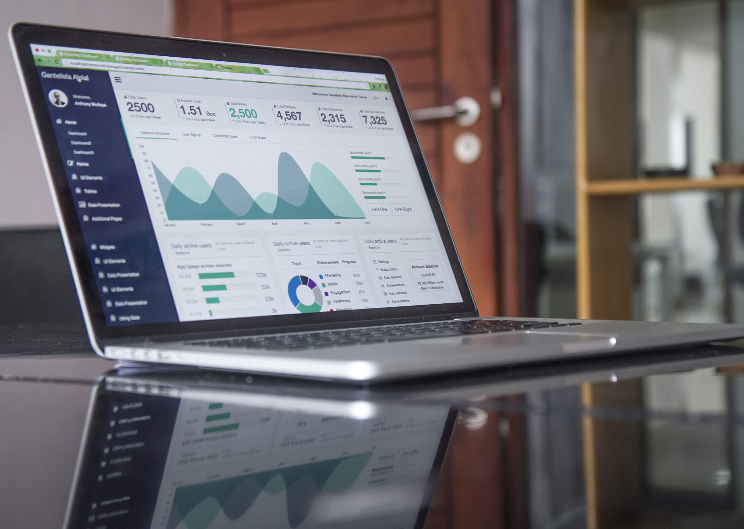
The machine learning workflow
First, the process starts with a training dataset, which contains a sequence of instances, where each instance has two components: the features and the correct prediction for those features. Next, a machine learning algorithm is trained on this training dataset to produce a machine learning model. This generated model can be used to make a prediction when given a new instance. A second dataset with features and correct predictions, called a test dataset, is used to assess the accuracy of the model. Since this test dataset is the same format as the training dataset, a set of instances of features and prediction pairs, often these two datasets derive from the same initial dataset. A random partitioning algorithm is used to split the initial dataset into training and test datasets.
Bias can enter the system in any of the three steps above. The training data set may be biased in that its outcomes may be biased towards particular kinds of instances. The algorithm that creates the model may be biased in that it may generate models that are weighted towards particular features in the input. The test data set may be biased in that it has expectations on correct answers that may be biased. These three points in the machine learning process represent points for testing and mitigating bias. In AI Fairness 360 codebase, we call these points pre-processing, in-processing, and post-processing.
To understand how bias can enter a machine learning model, we first review the basics of how a model is created in a supervised machine learning process.

Slide 7
03
The algorithms we use

Slide 8


The algorithms we use
We are now ready to utilize AI Fairness 360 (aif360) to detect and mitigate bias. We will use the German credit dataset, splitting it into a training and test dataset. We will look for bias in the creation of a machine learning model to predict if an applicant should be given credit based on various features from a typical credit application. The protected attribute will be "Age", with "1" (older than or equal to 25) and "0" (younger than 25) being the values for the privileged and unprivileged groups, respectively. For this first tutorial, we will check for bias in the initial training data, mitigate the bias, and recheck.

Slide 9
04
Specific steps

Slide 10
Specific steps
1.Import the aif360 toolkit and install it
2.Write import statements
3.Set bias detection options, load dataset, and split between train and test
4.Compute fairness metric on original training dataset
5.Mitigate bias by transforming the original dataset
6.Compute fairness metric on transformed training dataset
1
2
3
4
5
6

Slide 11
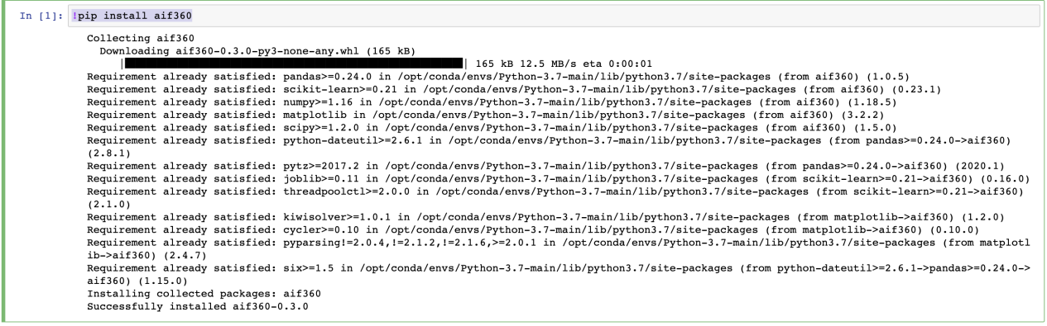
Specific steps
step1
We'll install the aif360 toolkit first.
!pip install aif360

Slide 12
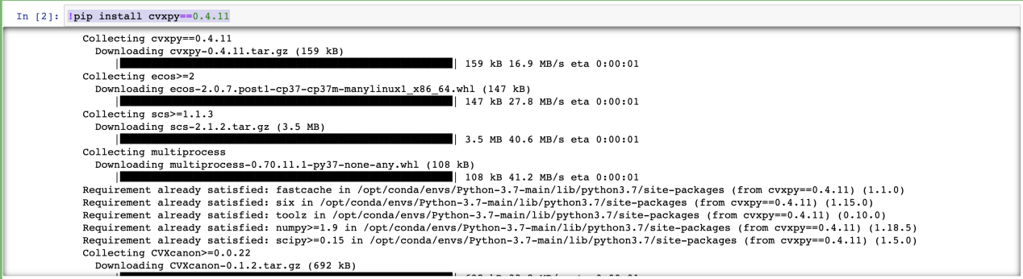
Specific steps
!pip install cvxpy==0.4.11
step2
As with any python program, the first step will be to import the necessary packages. Below we import several components from the aif360 package. We import the GermanDataset, metrics to check for bias, and classes related to the algorithm we will use to mitigate bias.
# Load all necessary packages
import sys sys.path.insert(1, "../") import numpy as np np.random.seed(0) from aif360.datasets import GermanDataset from aif360.metrics import BinaryLabelDatasetMetric from aif360.algorithms.preprocessing import Reweighing from IPython.display import Markdown, display

Slide 13
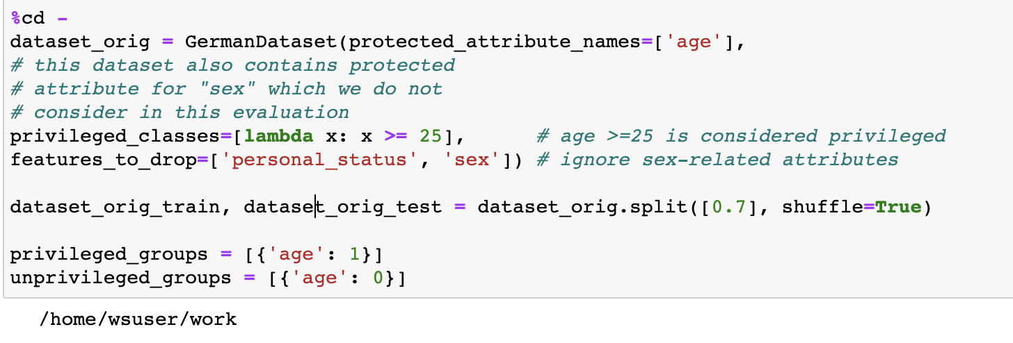
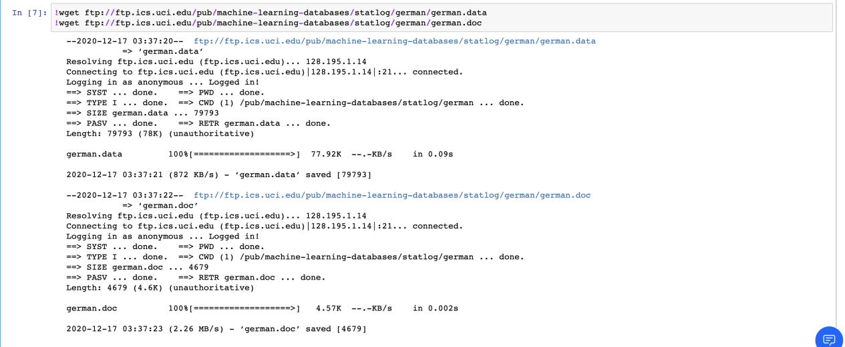
Specific steps
2.Then we load the initial dataset, setting the protected attribute to be age. We then split the original dataset into training and testing datasets. Note that we use a random seed number for this demonstration, which gives us the same result for each split(). Finally, we set two variables for the privileged (1) and unprivileged (0) values for the age attribute.
step3
1.we begin by dowloading the dataset. Then we load the initial dataset

Slide 14
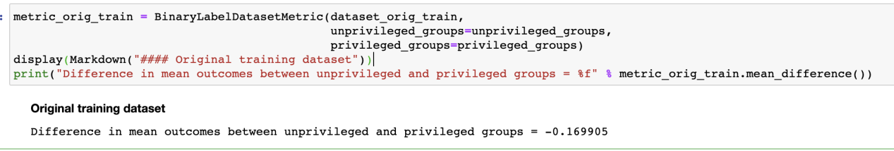
Specific steps
Now we can use aif360 to detect bias in the dataset. One simple test is to compare the percentage of favorable results for the privileged and unprivileged groups, subtracting the former percentage from the latter. A negative value indicates less favorable outcomes for the unprivileged groups.
step4
This is implemented in the method called mean_difference on the BinaryLabelDatasetMetric class. The code performs this check and displays the output, showing that the difference is -0.169905.This means that the privileged population has an advantage of nearly 17%, and the deviation appears

Slide 15
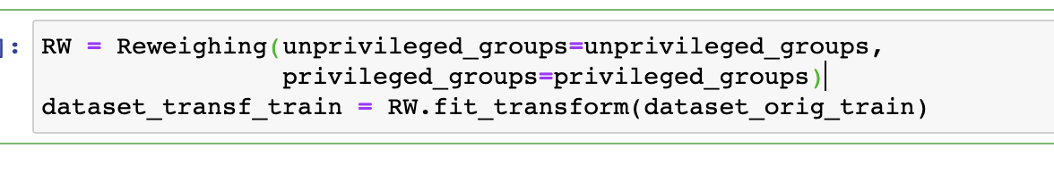
Specific steps
step5
The previous step showed that the privileged group was getting 17% more positive outcomes. Since this is not desirable, we are going to try to mitigate this bias in the training dataset. We will choose the Reweighing algorithm.This algorithm will transform the dataset to have more equity in positive outcomes on the protected attribute for the privileged and unprivileged groups.
We then call the fit and transform methods to perform the transformation, producing a newly transformed training dataset

Slide 16
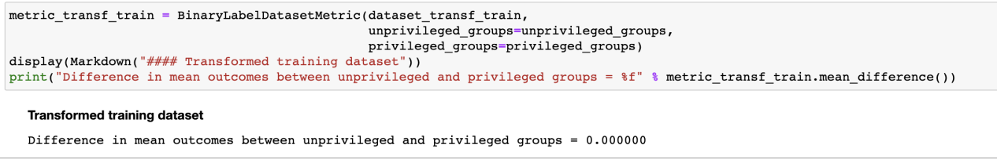
Specific steps
Now that we have a transformed dataset, we can check how effective it was in removing bias by using the same metric we used for the original training dataset in Step 3.
step6
We see the mitigation step was very effective, the difference in mean outcomes is now 0.0. So we went from a 17% advantage for the privileged group to equality in terms of mean outcome.

Slide 17
05
Summary

Slide 18

Summary
In conclusion,the AI Fairness 360 toolkit is an extensible open-source library containg techniques developed by the research community to help detect and mitigate bias in machine learning models throughout the AI application lifecycle.There are many metrics one can use to detect the presence of bias. AI Fairness 360 provides many of them for your use. Since it is not clear which of these metrics to use, we also provide some guidance. Likewise, there are many different bias mitigation algorithms one can employ, many of which are in AI Fairness 360.

Slide 19
Thank you for watching
THANK YOU!

